Slide 1
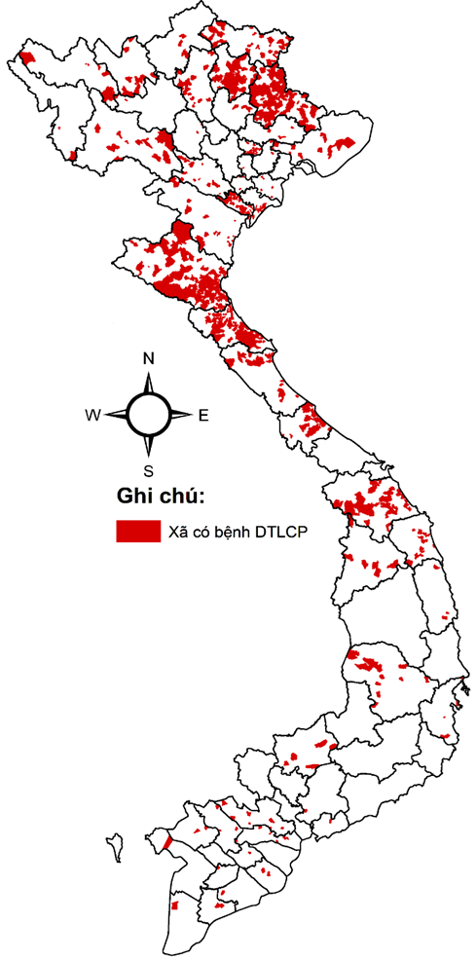
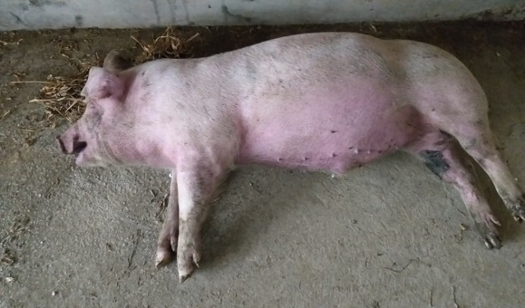
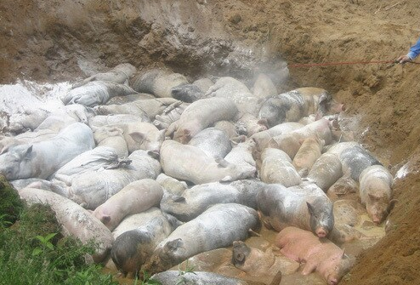
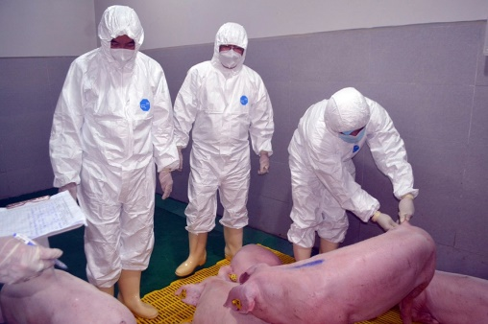
CURRENT SITUATION AND CONTROL
AFRICAN SWINE FEVER IN VIETNAM
PhD. DVM. DAO Duy Tung
NIVR Vietnam

Slide 2

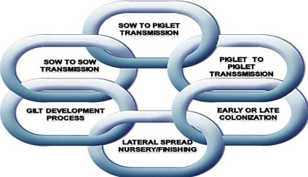

OUTLINES
AFS current situation
AFS vaccination and control strategies
NIVR Vietnam & RDA Korea (NIAS) collaboration

Slide 3
AFS CURRENT SITUATION IN VIETNAM

Slide 4
What we have observed in Viet Nam
ASF was first detected in Vietnam Feb 2019
  Similar location and speed of introduction as HP-PRRS in 2007
Quick spread to 23 provinces in 2 months and whole country in 5 months
  Similar speed of spread as HP-PRRS in 2007
  Approximate 20% (6m heads) of total pig population were culled.

Slide 5
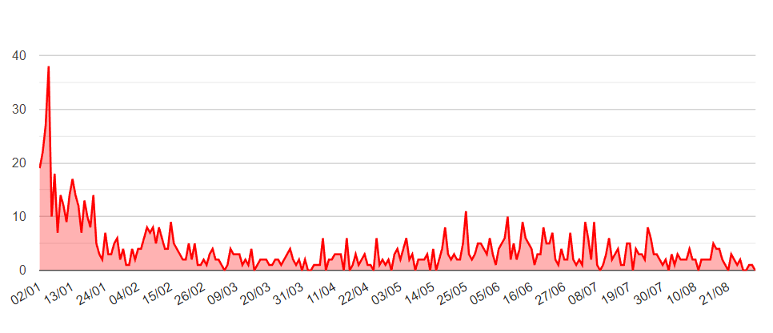
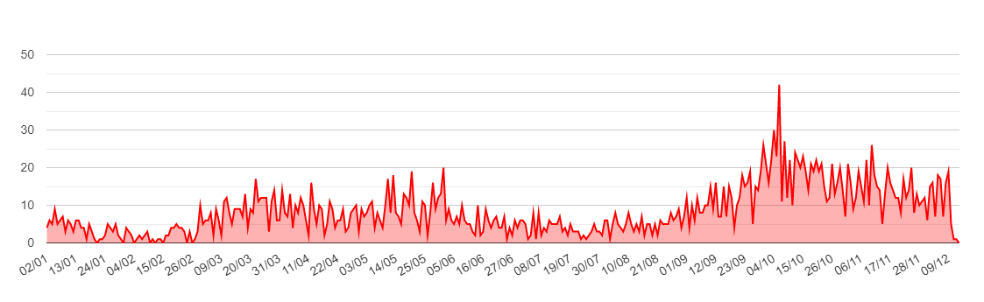
COMPARISION THE SITUATION OF AFS 2020 - 2022
Criteria | 2020 (Jan- Sep) | 2021 (Jan- Sep) | 2022 (Jan- Sep)
Total of pig | 16,521,068 | ~26,670,000 | 18,455,640 (estimated)
Number of disease district | 248 | 280 | 256
Number of disease province | 44 | 50 | 50
Number of dead& culling pig | 43,150 | 93,261 | 46,329
Rate (dead & culling/Total) | 0.26% | 0.35% | 0.25% (estimated)
Diagram of the evolution of AFS endemic 2021-2022

Slide 6
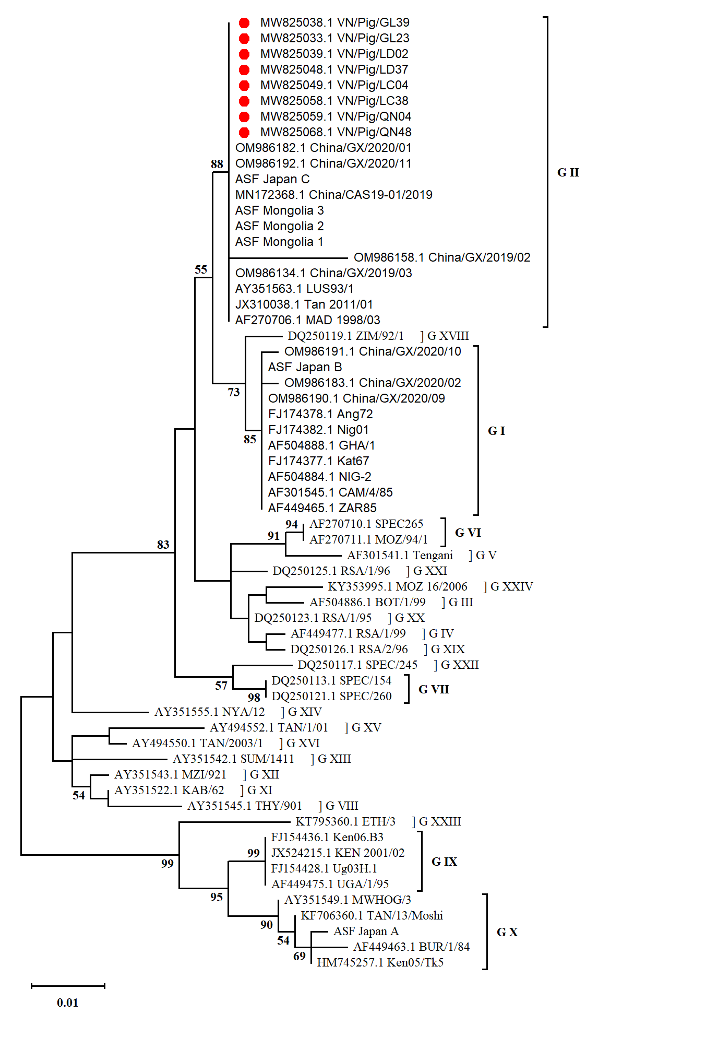
Genetic characterization of ASF viruses circulating in Vietnam
Vietnamese ASFV strains:
Genotype II.
Shared 100% (nt & aa) with Chinese ASFV strains
Source: VNUA Dr Nga
(a) 2019
(b) 2020
Fig. 2. Phylogenetic tree based on P72 gene of ASF

Slide 7
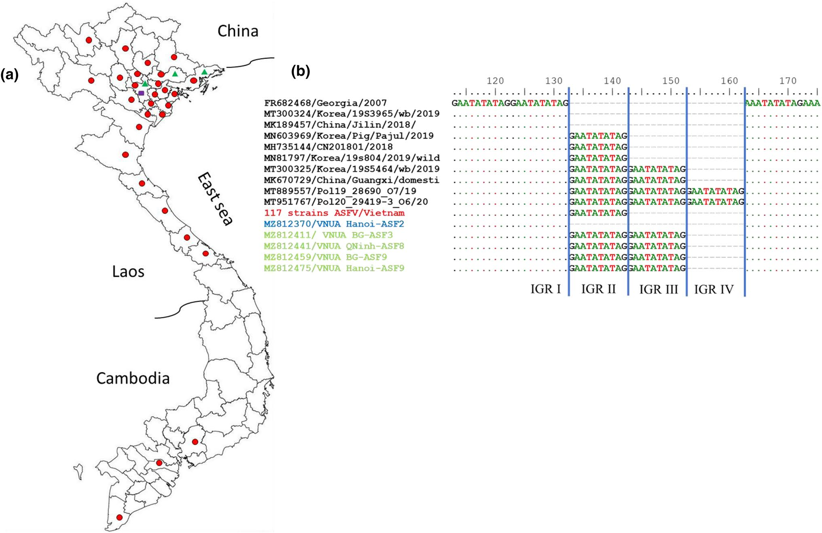
Genetic characterization of ASF viruses circulating in Vietnam (cont.)
Sequences between I73R and I329L showed 3 different variants of ASFV:
IGR I (1/122 strain),
IGR II (117/122 strains)- the most prevalent
IGR III (4/122 strains)- the frst time the presence of IGR III variants in Vietnam
Source: DOI: 10.1007/s00705-022-05363-4

Slide 8
AFS VACCINATION AND CONTROL STRATEGIES

Slide 9
Vaccination
In Vietnam, 03 companies with sufficient resources and experience in research and production of African swine fever vaccines, including:
National Veterinary Joint Stock Company (NAVETCO)
AVAC Vietnam Company Limited
Dabaco Group Joint stock Company

Slide 10
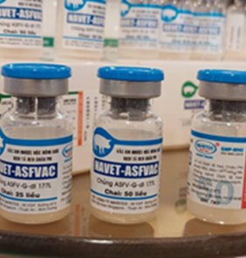
Vaccination (cont.)
One company has research results on trial AFS vaccine that are recognized as meeting standards at the laboratory scale
Vaccine: NAVET-ASFVAC
Vaccine company: National Veterinary Joint Stock Company (NAVETCO)

Slide 11
Vaccination (cont.)
Vaccine: NAVET-ASFVAC
03 batches of vaccines passed the quality requirements in accordance with regulations for:
  Sterility,
  Safety
  Effectiveness (by challenge)
(by the Central Veterinary Drug Testing Center I )
Currently in testing and evaluation at the field scale

Slide 12
Control strategies
Focusing on information and communication activities on AFS prevention and control, enhancing biosecurity.
Organize monitoring, early detection, timely warning and thorough handling of newly outbreaks.
Establishing the safe value chains, the free animal disease areas.
Organize and closely supervise the gathering and trading of pigs and pig products; strictly handle the illegal cases of transporting, trading, importing and unknown origin.

Slide 13
Control strategies (cont.)
Continuing to review and re-evaluate the quality of vaccine batches used in localities; conduct in-depth testing and analysis (sick pig samples, post-vaccination pigs, vaccine samples, etc.) to find out the exact causes.
To organize intensive research on epidemiological, viral characterization and production of domestic vaccines against ASF.
To collaborate with international organizations and countries in sharing and supporting Vietnam to prevent & control ASF.

Slide 14
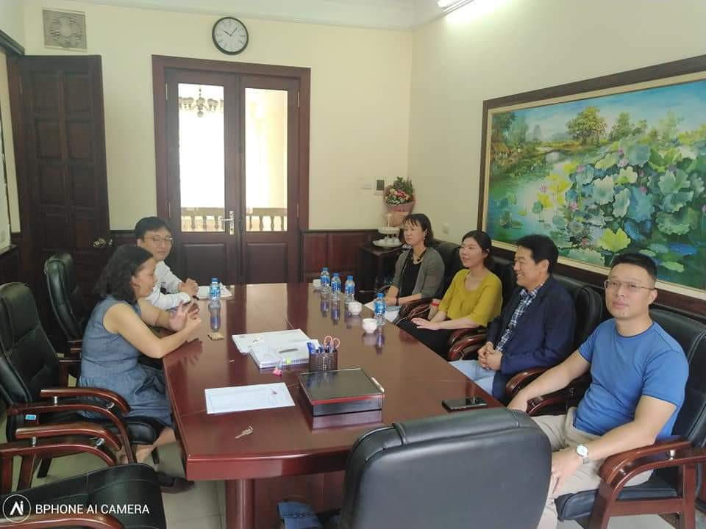
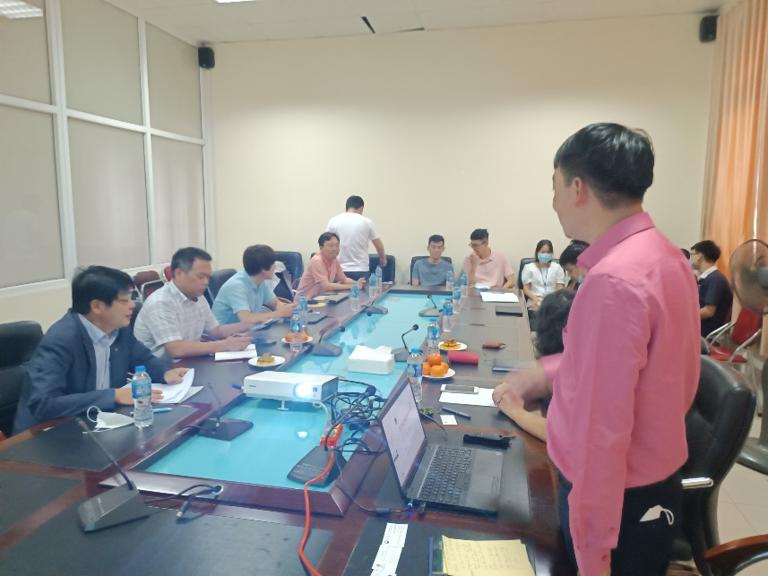
NIVR VIETNAM & RDA KOREA (NIAS) COLLABORATION

Slide 15

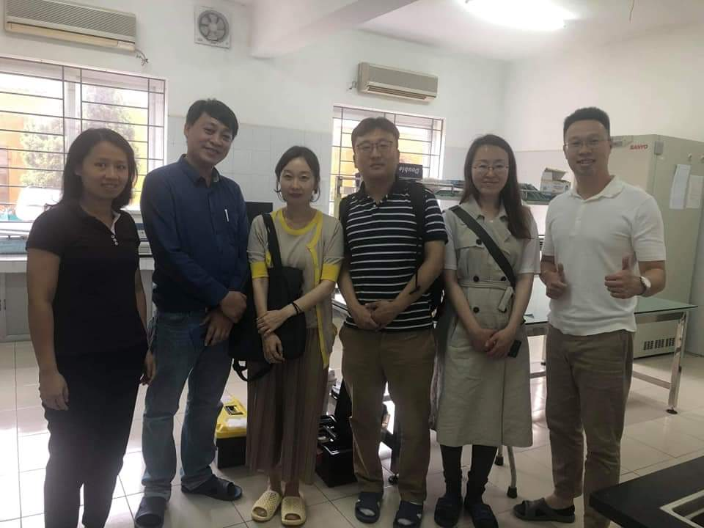
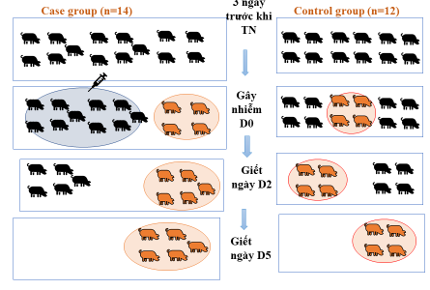
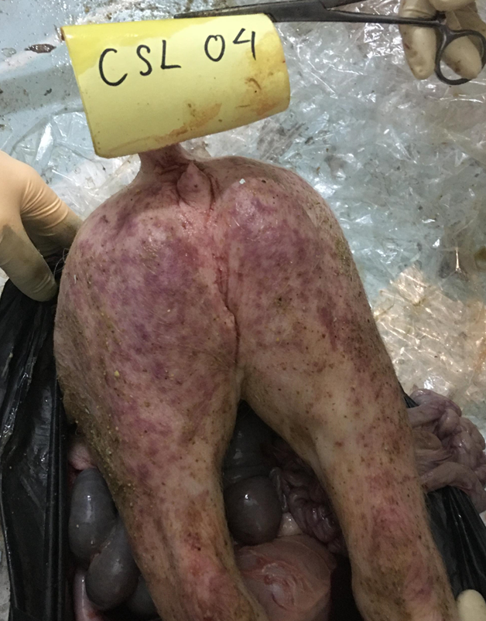
Project: Gene expression profiling analysis of AFS virus after experiment infection in pigs in Vietnam
Period: 2019- 2021
Objective:
Host tissues & transcriptomic data collection from in vivo AFSV infection for disease resistance in pigs
Identification of gene expression profiling of AFSV after experiment infection in pigs
Comparison of the genome sequencing data between commercial and African indigenous pigs
  Work flow
ILRI
Provide Warthog pig samples
Clinical data generation
NIVR
Challenge experiment.
Gene expression in host genome
Sampling of host tissue
NIAS
Host genome data generation
Transcriptome data generation
Gene expression analysis
The results are being analyzed by NIAS to find the disease resistance genes

Slide 16
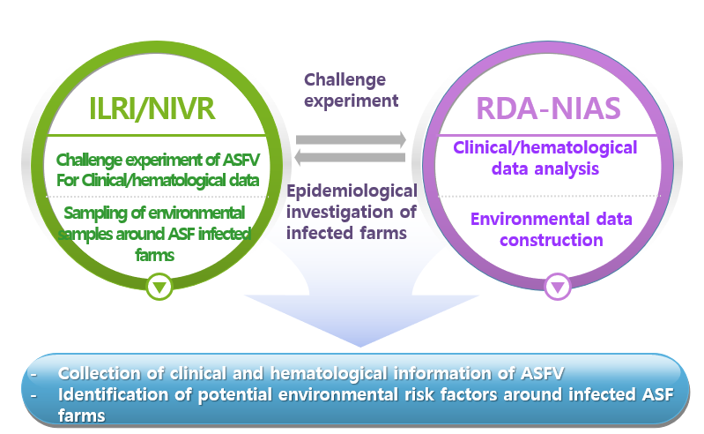
Project: Analysis and monitoring of clinical and epidemiological features of African Swine fever
Period: 2020- 2021
Objective:
To identify the clinical signs and hematological characteristics of African swine fever (ASF) after experimental infection in pigs
To analysis the ASF virus secretion routes after experimental ASF virus (ASFV) infection in pigs
To evaluate the possible risk factors for the transmission of ASFV around infected farms
  Work flow

Slide 17
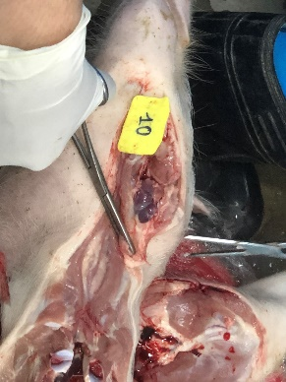
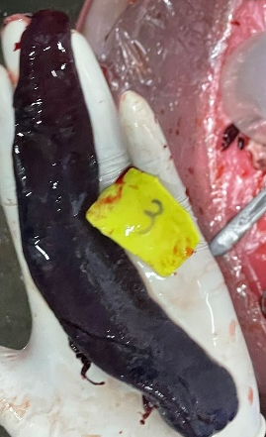
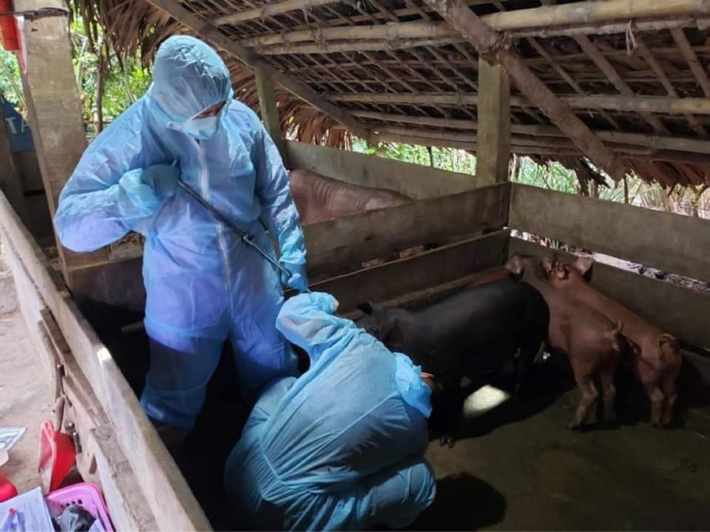
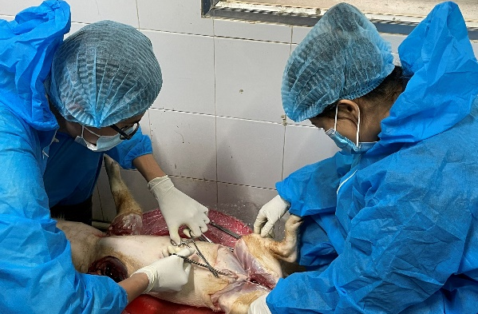
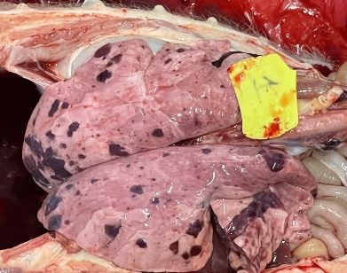
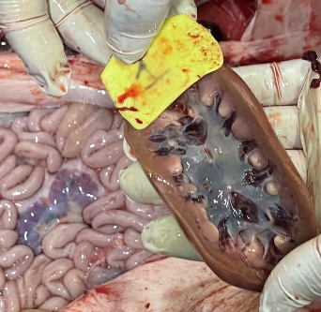
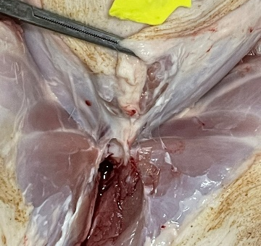
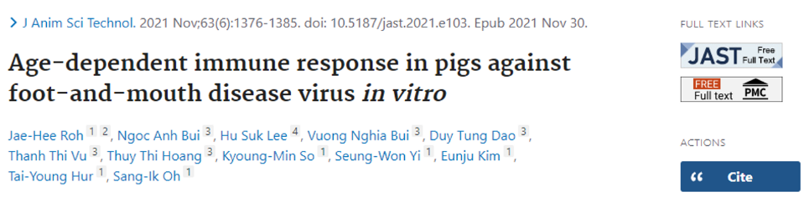
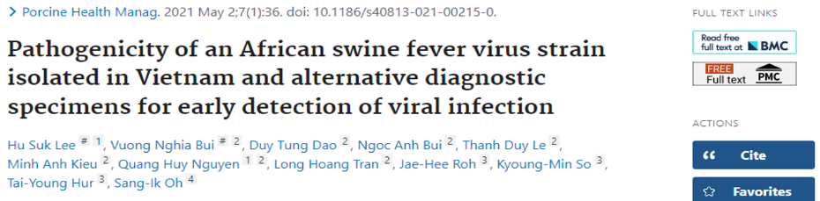
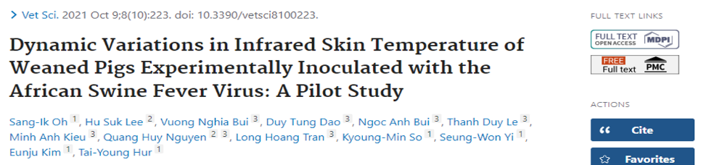
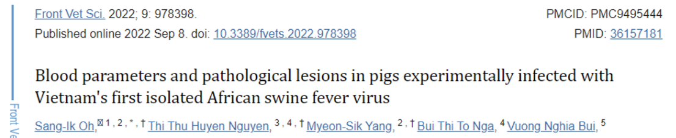
Project: Analysis and monitoring of clinical and epidemiological features of African Swine fever (2020-2021 cont.)
Experiment activities
  04 Publications

Slide 18
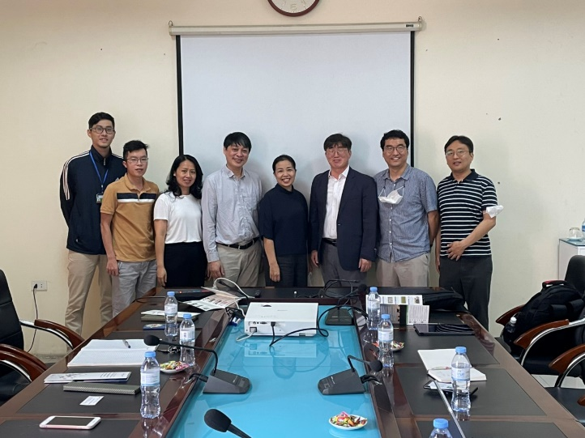
Project: Analysis and monitoring of clinical and epidemiological features of African Swine fever
Period: 2022- 2024
Objective:
To establish the spread model of AFS virus infection
To investigate the mutation of ASFV
  Project work:
Spread virus in pens: Evaluate the spread of ASFV among pigs
Dose dependent ASFV infection per oral: Evaluate the minimum threshold of ASFV infection by P.O. (feed intake)
Evaluation of ASFV mutation across the Vietnam(2022-2024): To investigate the ASFV mutant strain in Vietnam
ASFV transmission model among farms (2022-2024) in Vietnam: To develop ASF transmission model among farms in Vietnam.

Slide 19

Thank you very much!

